Slide 1
CIS9660: Data Mining for Business Analytics 7. Association Rule Mining
(Gujarati, D.N., 2011. Econometrics by example. New York: Palgrave Macmillan. Chapter 12)

Slide 2
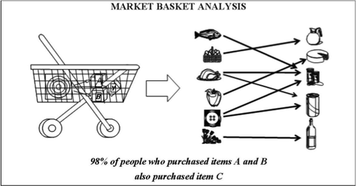
What is Association Rule Mining?
Attempt to find interesting associations between entities based on transactions involving them
Identify frequent if-then associations
Also known as “affinity analysis” or “market basket” analysis
Notes:
How is it different from decision trees?
How is it different from clustering?

Slide 3

What is Association Rule Mining?
Assume all data are categorical
Not a good algorithm for numeric data
An association rule has two parts:
an antecedent (if) and a consequent (then)
Initially used for Market Basket Analysis to find how items purchased by customers are related
e.g., if a customer buys A, then there is an 80% chance she/he will also buy B

Slide 4
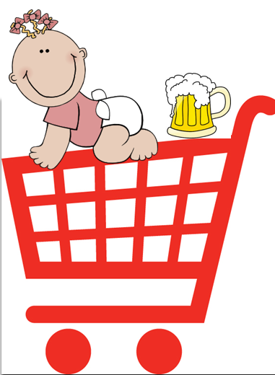
Applications
Diapers and beer:
Most famous example of association rule mining
If you buy diapers, you tend to buy beer
Why?
How can this help business?

Slide 5
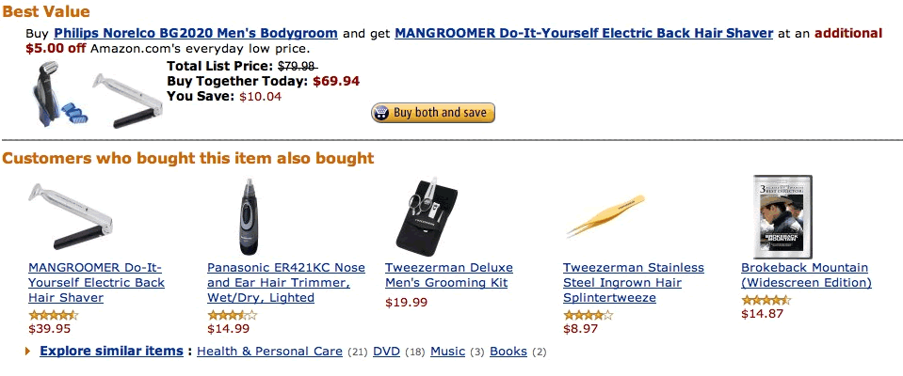
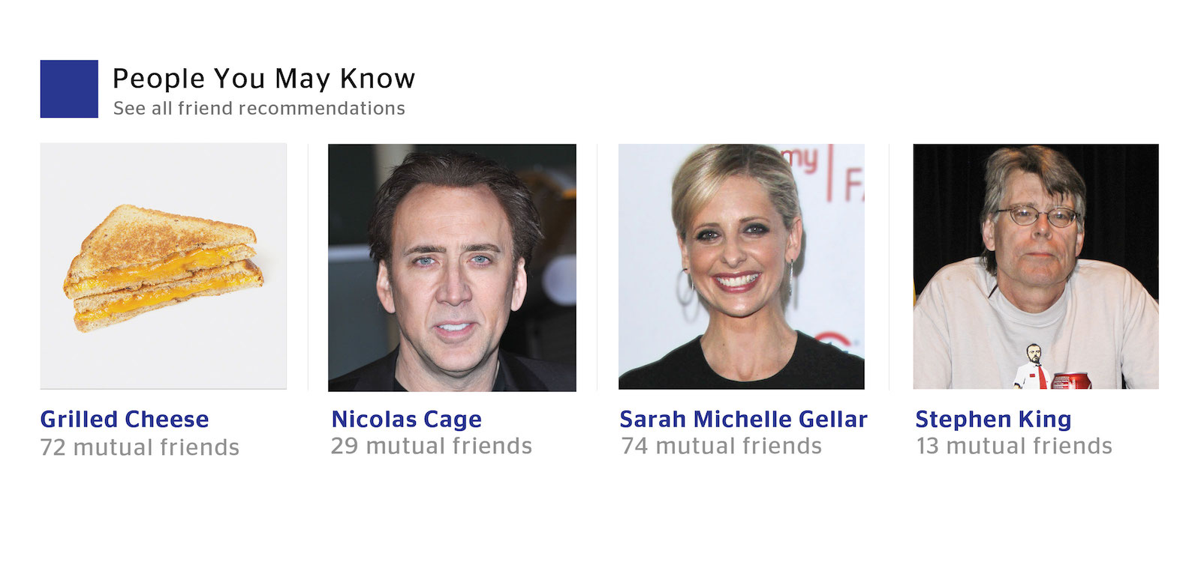
Other Applications

Slide 6

Supervised or Unsupervised?
Supervised
If we want specifically to understand what correlates most with a corresponding target variable
Unsupervised
If we want to explore the data without a specific goal

Slide 7
Association Rule Mining: Important Measures
Ideally, we want to create all possible combinations of items
Challenge: computation time grows exponentially as # of items increases
Solution: consider only “frequent item sets”
Criterion for “frequent”: support

Slide 8
Association Rule Mining: Important Measures
Support:
Support is an indication of how frequently the itemset appears in the dataset
The support is sometimes expressed as a percentage of the total number of A and B together in the database; it is p(A,B)
Coverage of the association rule
Help to efficiently discover association rules
A constraint of minimum support is often applied in order to control complexity
E.g., we require rules to apply to at least 0.01% of all transactions

Slide 9
Association Rule Mining: Important Measures
Confidence:
Confidence is an indication of how often the rule has been found to be true
The probability that B occurs when A occurs; it is p(B/A)=p(A,B)/p(A)
Accuracy of the association rule
Measures the reliability of the inference made by a rule
A threshold of minimum confidence is often applied in order to control complexity
E.g., we require 5% or more of the time, a buyer of A also buy B

Slide 10
Association Rule Mining: Important Measures
Lift:
Lift is the ratio of confidence to expected probability of consequent event Lift(A,B)=p(A,B)/[p(A)p(B)]
Measure how much more frequently the associate rule occurs than by chance
Strength of the association rule

Slide 11
Association Rule Mining: Important Steps
List all possible association rules
Compute the support and confidence for each rule
Drop rules that don’t pass the thresholds
Use lift to further check the association
Set a minimum support and confidence threshold

Slide 12
Example: Market-Basket Transactions
Basket | Items
1 | Bread, Milk
2 | Bread, Diapers, Beer, Eggs
3 | Milk, Diapers, Beer, Coke
4 | Bread, Milk, Diapers, Beer
5 | Bread, Milk, Diapers, Coke
We usually start from a data set like this – with baskets of transactions
And the idea is to find associations between products
Notes:
The first question is, how do we know which item sets to focus on when exploring association rules?

Slide 13
Example: Market-Basket Transactions
Basket | Items
1 | Bread, Milk
2 | Bread, Diapers, Beer, Eggs
3 | Milk, Diapers, Beer, Coke
4 | Bread, Milk, Diapers, Beer
5 | Bread, Milk, Diapers, Coke
A → B (antecedent → consequent)
(aka LHS →RHS)
{Diapers} → {Beer}, {Milk, Bread} → {Diapers} {Beer, Bread} → {Milk}, {Bread} → {Milk, Diapers}
Association Rules from these transactions

Slide 14
Core Idea: the Itemset
Itemset A group of items of interest {Milk, Diapers, Beer}
How to choose items of interest?
Association rules express relationships between itemsets
A → B {Milk, Diapers} → {Beer}
“when you have milk and diapers, you are also likely to have beer”
Basket | Items
1 | Bread, Milk
2 | Bread, Diapers, Beer, Eggs
3 | Milk, Diapers, Beer, Coke
4 | Bread, Milk, Diapers, Beer
5 | Bread, Milk, Diapers, Coke

Slide 15
Support Count (σ)
Support count (σ)
In how many baskets does the itemset appear?
σ{Milk, Diapers, Beer} = 2 (i.e., in baskets 3 and 4)
You can calculate support for both A (Milk, Diaper) and B (Beer) separately
σ{Milk, Diapers} = 3
σ{Beer} = 3
Basket | Items
1 | Bread, Milk
2 | Bread, Diapers, Beer, Eggs
3 | Milk, Diapers, Beer, Coke
4 | Bread, Milk, Diapers, Beer
5 | Bread, Milk, Diapers, Coke
2 baskets have milk, beer, and diapers
5 baskets total

Slide 16
Support (s)
Basket | Items
1 | Bread, Milk
2 | Bread, Diapers, Beer, Eggs
3 | Milk, Diapers, Beer, Coke
4 | Bread, Milk, Diapers, Beer
5 | Bread, Milk, Diapers, Coke
Support (s)
Fraction of transactions that
contain all items in the itemset
s({Milk, Diapers, Beer})
= σ{Milk, Diapers, Beer} /(# of transactions)
=2/5 = 0.4
You can calculate support for both A and B separately
Support for A: s{Milk, Diapers}= 3/5 = 0.6
Support for B: s{Beer}= 3/5 = 0.6
A
B
This means 40% of the baskets contain Milk, Diapers and Beers

Slide 17

How to Set the Value of Minimum Support?
A high value may exclude important associations
Rare item problem: in many applications, some profitable items rarely appear
E.g., in a supermarket, people buy food processor and cooking pan much less frequently than they buy bread and milk
A low value may include too many insignificant associations

Slide 18
Single vs. Multiple Min-supports Model
Single min-support
All items can have a same minimum item support
It assumes that all items in the data are of the same nature and/or have similar frequencies
Multiple min-support model
Each item can have a minimum item support
It is a more realistic model for practical applications
The model can find rare item rules yet without producing a huge number of meaningless rules with frequent items

Slide 19
Confidence (c)
Basket | Items
1 | Bread, Milk
2 | Bread, Diapers, Beer, Eggs
3 | Milk, Diapers, Beer, Coke
4 | Bread, Milk, Diapers, Beer
5 | Bread, Milk, Diapers, Coke
Confidence (c) is the strength of the association
Measures how often items in B appear in transactions that contain A
A
B
A
B
A
Support for total itemset A and B
Support for B
c must be between 0 and 1 1 is a complete association
0 is no association
This says 67% of the times when you have milk and diapers in the itemset you also have beer!

Slide 20
Calculating and Interpreting Confidence
Basket | Items
1 | Bread, Milk
2 | Bread, Diapers, Beer, Eggs
3 | Milk, Diapers, Beer, Coke
4 | Bread, Milk, Diapers, Beer
5 | Bread, Milk, Diapers, Coke
Association Rule (A→B) | Confidence (A→B) | What it means
{Milk,Diapers} → {Beer} | 0.4/0.6 = 0.67 | 2 baskets have milk, diapers, beer 3 baskets have milk and diapers So, 67% of the baskets with milk and diapers also have beer
{Milk,Beer} → {Diapers} | 0.4/0.4 = 1.0 | 2 baskets have milk, diapers, beer 2 baskets have milk and beer So, 100% of the baskets with milk and beer also have diapers
{Milk} → {Diapers,Beer} | 0.4/0.8 = 0.5 | 2 baskets have milk, diapers, beer 4 baskets have milk So, 50% of the baskets with milk also have diapers and beer

Slide 21
High confidence suggests a strong association…
But a strong association may happen by chance. Consider {Bread} →{Diapers}
Support for the total itemset is 0.6 (3/5)
And confidence is 0.75 (3/4) – pretty high
But is this just because both are frequently occurring items (s=0.8)? You’d almost expect them to show up in the same baskets by chance

Slide 22
Lift
Takes into account how co-occurrence differs from what is expected by chance
i.e., if items were selected independently from one another
A
B
Support for total itemset A and B
A
B
A
B
Support for A times support for B

Slide 23
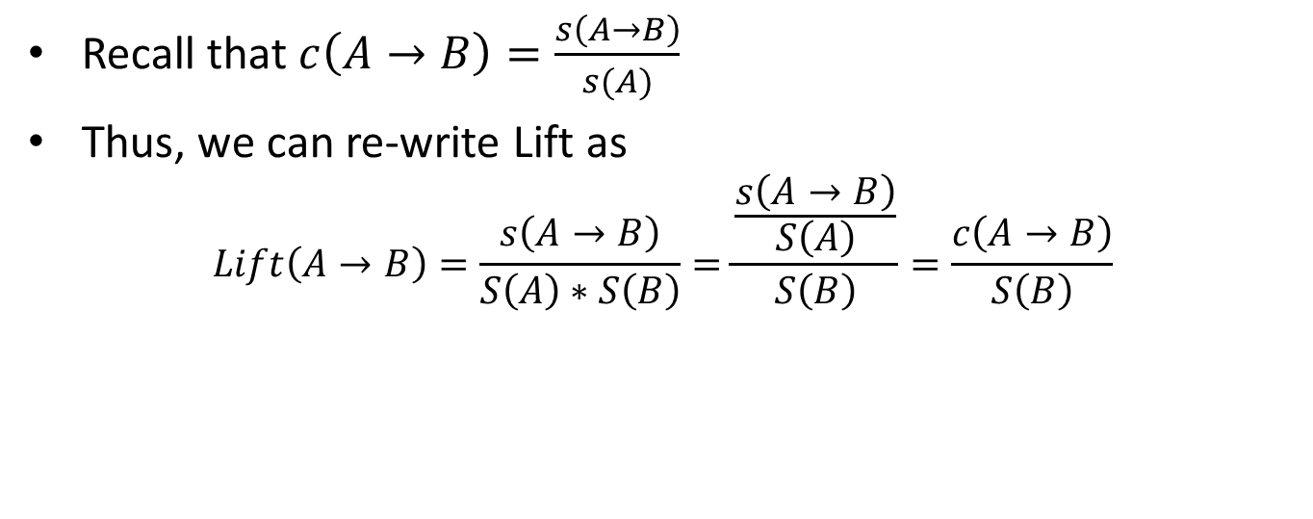
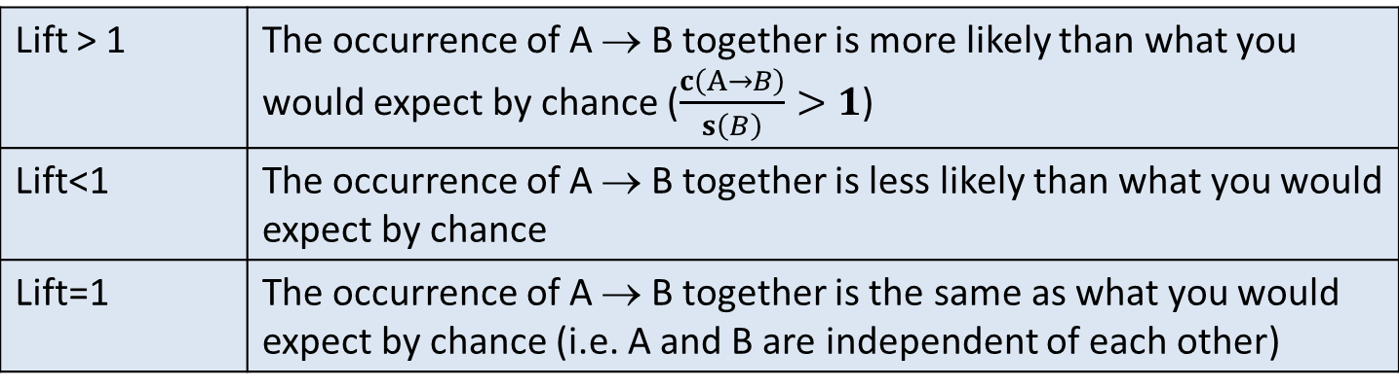
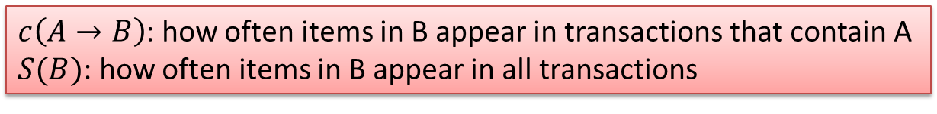
Lift
Recall that$c\left(A→B\right)=\frac{s\left(A→B\right)}{s(A)}$
Thus, we can re-write Lift as
$$Lift\left(A→B\right)=\frac{s\left(A→B\right)}{S\left(A\right)∗S\left(B\right)}=\frac{\frac{s\left(A→B\right)}{S\left(A\right)}}{S\left(B\right)}=\frac{c\left(A→B\right)}{S\left(B\right)}$$
$c\left(A→B\right)$: how often items in B appear in transactions that contain A
$S(B)$: how often items in B appear in all transactions
Lift > 1 | The occurrence of A → B together is more likely than what you would expect by chance ($\frac{c\left(A→B\right)}{s\left(B\right)}>1$)
Lift<1 | The occurrence of A → B together is less likely than what you would expect by chance
Lift=1 | The occurrence of A → B together is the same as what you would expect by chance (i.e. A and B are independent of each other)
Notes:
Why one is the most interesting?

Slide 24

Example
Basket | Items
1 | Bread, Milk
2 | Bread, Diapers, Beer, Eggs
3 | Milk, Diapers, Beer, Coke
4 | Bread, Milk, Diapers, Beer
5 | Bread, Milk, Diapers, Coke
What’s the lift for the rule: {Milk, Diapers} → {Beer}
So A = {Milk, Diapers} B = {Beer} s{Milk, Diapers} → {Beer}) = 2/5 = 0.4 s({Milk, Diapers}) = 3/5 = 0.6 s({Beer}) = 3/5 = 0.6 So
When Lift > 1, the occurrence of A → B together is more likely than what you would expect by chance

Slide 25
Another Example
 | Netflix
Cable TV |  | No | Yes
 | No | 200 | 3800
 | Yes | 8000 | 1000
What is the effect of Netflix on Cable TV? {Netflix → CableTV)
Total = 200 + 3800 + 8000 + 1000 = 13000
People with both services = 1000/13000 → 7%
People with Cable TV = (8000+1000)/13000 → 69%
People with Netflix = (3800+1000)/13000 → 37%

Slide 26
Another Example
t1: Beef, Chicken, Milk
t2: Beef, Cheese
t3: Cheese, Boots
t4: Beef, Chicken, Cheese
t5: Beef, Chicken, Clothes, Cheese, Milk
t6: Chicken, Clothes, Milk
t7: Chicken, Milk, Clothes
Transaction data
An example frequent itemset:
{Chicken, Clothes, Milk} [sup = 3/7]
Association rules from the itemset:
Clothes → Milk, Chicken [sup = 3/7, conf = 3/3, lift=conf/P(B)=1/4/7=7/4=1.75]
Calculate the lift by yourself

Slide 27
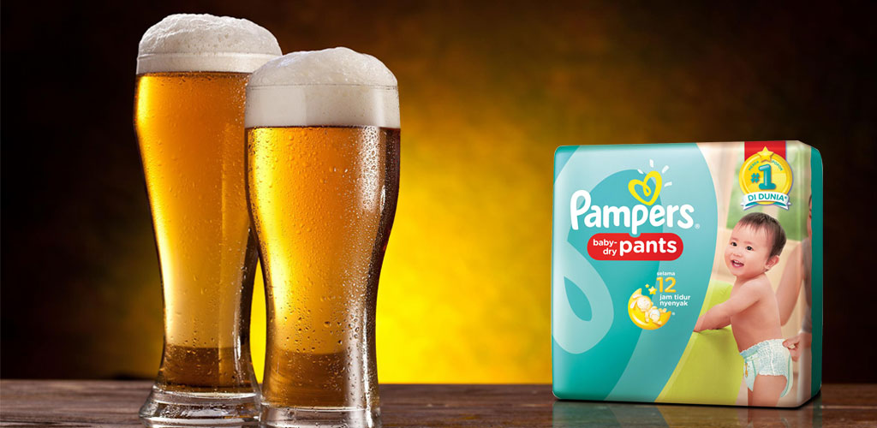
Once Confident in a Rule, Take Actions
{Diapers} → {Beer}
Possible Marketing Actions
Create “New Parent Coping Kits” of beer and diapers
What are some others?
Can we use association rule mining for classification?
Can we use association rule mining for clustering?
Notes:
Can you predict the Right amount of the right merchandise at the right time?
Very limited applications. As a lot of information is lost during the process
What is the difference between decision tree and association rules? Can you input continuous variables for decision trees? Yes, can you input continuous variables for associations? No.

Slide 28
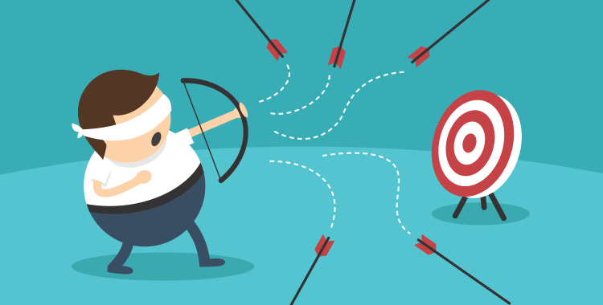
But Do Not Blindly Follow the Numbers
A simplistic view of shopping baskets
Some important information not considered. E.g,
the quantity of each item purchased and
the price paid
Analytics insights aren't always actionable
Random data can generate apparently interesting association rules
Association does not imply causality
The more rules you produce, the greater the danger is
Be careful when you take someone else's model and apply it in your environment
Notes:
Causality, on the other hand, requires knowledge about which attributes in the data capture cause and effect, and typically involves relationships occurring over time (e.g., greenhouse gas emissions lead to global warming).

Slide 29
Diapers and Beer: Revisited
Attempts to Repeat the Finding
Through the rest of the 1990s, in a number of different retail settings, Madsen validated and then invalidated the claimed correlation. "Somewhere around 1993 or 1994, I was working in a drug store chain and I read this and I thought it seemed legit. [However,] a year later, working in a grocery store chain, I had access to all of this data, and I tried it, but I found no correlation," he said.
Later on, Madsen was working with another drug store chain in which he was able to validate the beer-and-diapers correlation.
Then in 1997, he found a case in which the correlation seemed especially strong. "There was a 0.95 correlation. I asked them about it. They said, 'We read this article in Chain Store Agemagazine that said beer and diapers are correlated, so we put beer next to diapers in all of our stores,"
In another drug store retailer that same year, he found no correlation. Then, while working with a grocery retailer in the year 2000, he found an example of very weak correlation.
(https://tdwi.org/articles/2016/11/15/beer-and-diapers-impossible-correlation.aspx)

Slide 30
Interesting Applications of Data Mining
Detect credit card default (decision tree, association rule mining)
Detect watermelon ripeness (ripe or not, decision tree, association rule mining)
Detect handwritten signatures fraud (fraud or not, decision tree; clustering, split signature based on similarity)
Suggest customers for bank account promotions (a group of customer, clsuering; decision tree, yes)
Suggest friends on Facebook (recommendation of friends, clutsering; association rule mining, assoctaion between each two users)
Suggest a perfect match for online dating

Slide 31
Summary
What is association rule mining?
What are the important measures?
Support, confidence, and lift
Explain what each means
Can you have high confidence and low lift at the same time?
How to compute
In what conditions, you can use this data mining method?

